Slide 1
STEM Portfolio 2026
MyName
(decorate this slide as you see fit)

Slide 2
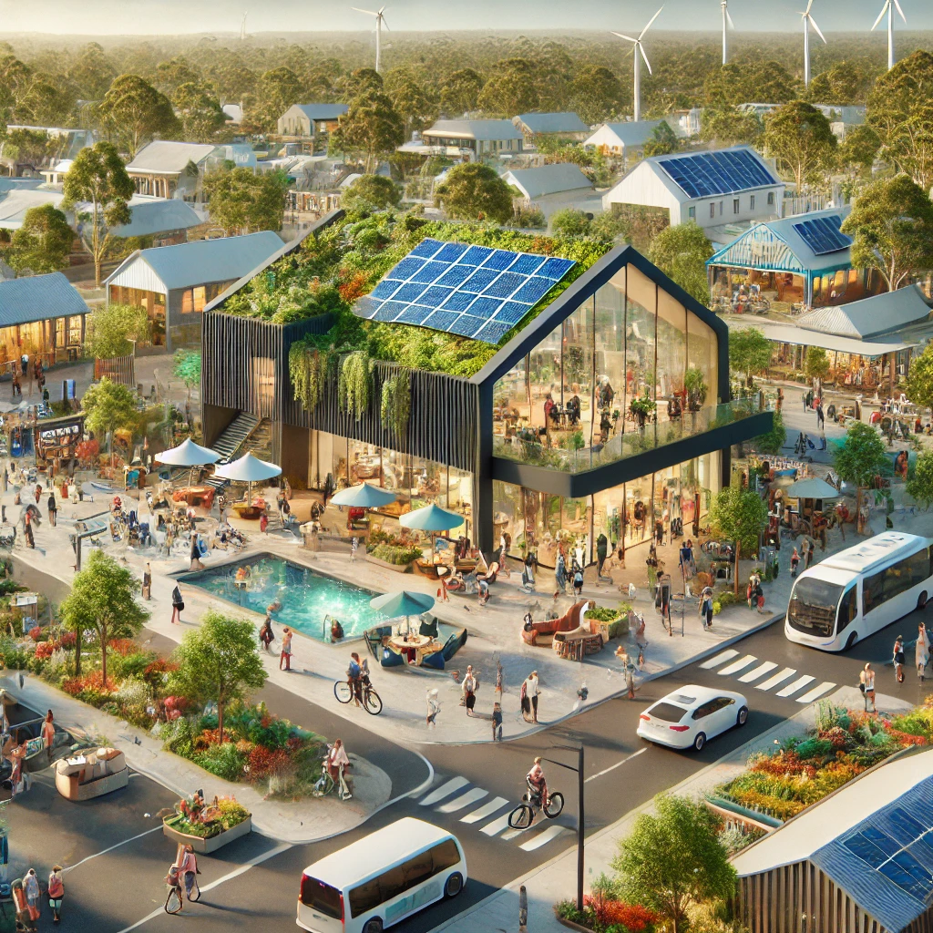
Our Town 2050
Investigating and Defining
Generating and Designing
Producing and Implementing
Evaluating
Planning and Managing

Slide 3
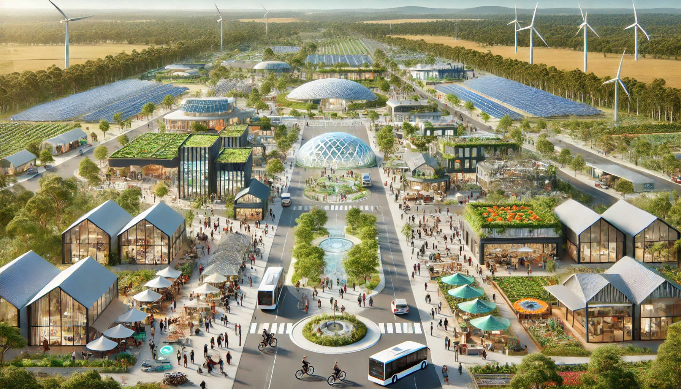
Investigating & Defining
How can you redesign elements of your town to ensure it thrives in 2050?
Generating & Designing
Producing & Implementing
You will all be using the design process in this learning experience.
Design Challenge
Discover
Define
Refine
Deliver
Discuss
Planning & Managing
Ideate
Develop
Showcase
Investigating & Defining
Generating & Designing
Producing & Implementing
Evaluating
Evaluating

Slide 4
Investigating & Defining
Suggested Timeline of Student-Centered Activities
Session | Stage | Activity
1 | Investigating & Defining | Explore Solarpunk & Annotate Image
1 | Investigating & Defining | Future Challenges Reflection
2 | Investigating & Defining | Mind Map of Key Issues
2 | Investigating & Defining | Sustainability Analysis (3 Pillars)
3 | Investigating & Defining | Visual Research of Structures
4 | Investigating & Defining | Design Brief (Starburst Template)
4 | Investigating & Defining | Evaluation Criteria
5 | Generating & Designing | Morphological Matrix & Idea Generation
5 | Generating & Designing | Sketches & Concept Features
6 - 8 | Producing & Implementing | Final Design (CAD or Sketch)
9 | Planning and Managing | Production Planning
10-14 | Producing & Implementing | Model Making
15 | Evaluating | Design Reflection & Impact Evaluation
Generating & Designing
Producing & Implementing
Planning & Managing
Evaluating

Slide 5
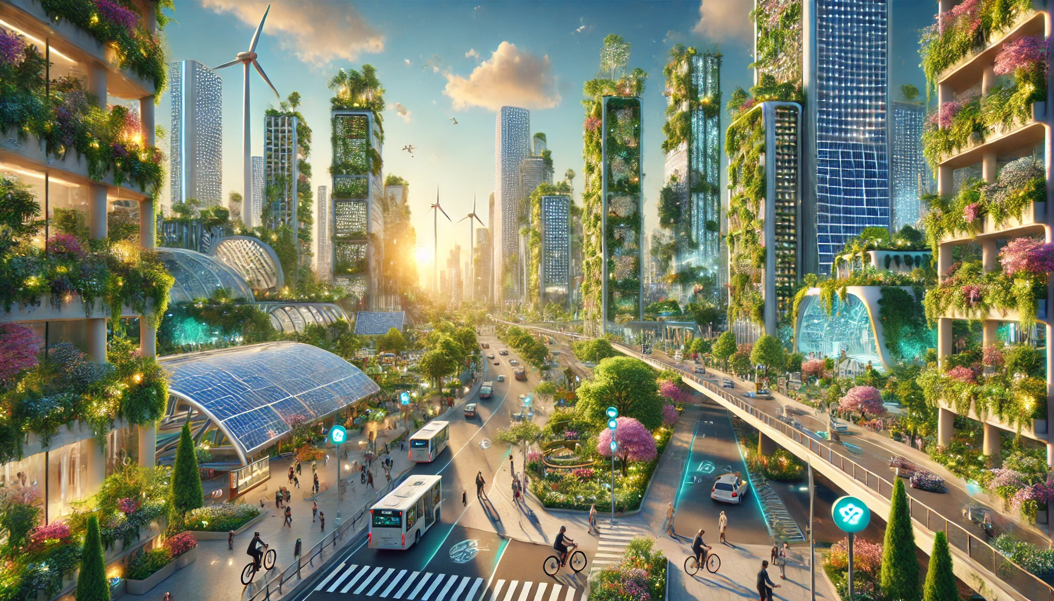
LEARNING MAP
(Depending On Student Choices)
Investigating & Defining
Curriculum Area | Content Description
Design and Technologies | Investigate how people in design and technologies occupations address competing considerations, including sustainability, when designing products, services and environments for current and future use
 | Analyse how the design and innovation of products, services, and environments can respond to changing needs, opportunities, or sustainability challenges
 | Generate, test, iterate and communicate design ideas, processes and solutions using technical terms and graphical representation techniques and appropriate attributions
 | Investigate and make judgments on how characteristics and properties of materials, systems, components, tools, and equipment can be combined to create designed solutions
 | Evaluate design ideas, processes and solutions based on functional, aesthetic, ethical, environmental, economic and social factors using evaluation criteria developed with consideration of sustainability
 | Effectively and safely use a broad range of materials, components, tools, equipment, and techniques to produce designed solutions for intended purposes
Critical and Creative Thinking | Pose questions to probe assumptions and investigate complex issues
 | Investigate and evaluate the strength of arguments and evidence in assessing conflicting perspectives
Geography | The distribution and influence of accessibility to services and facilities on people’s perceptions of the liveability of places
 | Examine strategies to create sustainable futures in relation to environmental, economic and social challenges, and explain the likely effects of these strategies
Ethical Capability | Examine how problems may contain more than one ethical issue, comparing the relative significance of each issue and recognising areas of contestability
 | Explore the extent of ethical obligation and the tension between respecting the rights of others and having a responsibility to the wider community
Sustainability | Analyse and evaluate the impact of decisions and actions on the sustainability of resources
 | Reflect on how sustainable practices and worldviews influence the development of strategies that support sustainable futures
Generating & Designing
Producing & Implementing
Planning & Managing
Evaluating

Slide 6
Feedback Rubric
Investigating & Defining
Stage | Task | Below the Level | Working Towards the Level | At the Level | Above the Level
Investigating & Defining | Explore Solarpunk & Annotate Image | Image is missing or lacks annotations | Image is present with minimal annotations or unclear links to town redesign | Image is annotated with relevant elements and clear connections to town redesign | Image is annotated with insightful comments and detailed connections to sustainability and urban design
 | Future Challenges Reflection | Few or no challenges identified, lacks explanation | Some challenges identified, but explanations are brief or unclear | Challenges are well-identified with clear reasoning for their impact | Challenges are thoroughly analyzed with deep insights and examples
 | Mind Map of Key Issues | Mind map is incomplete or lacks structure | Mind map identifies some key issues, but connections are weak | Mind map effectively organizes key issues and related aspects | Mind map is detailed, well-structured, and shows deep analysis of interconnections
 | Sustainability Analysis (3 Pillars) | Few sustainability solutions presented, lacks explanation | Some sustainability solutions identified but not well-supported | Sustainability solutions are well-explained across social, economic, and environmental aspects | Sustainability solutions are highly innovative, well-researched, and linked to real-world examples
 | Visual Research of Structures | Few images collected, no annotations | Some images collected with minimal annotations | A variety of images with clear annotations explaining relevance | Highly relevant images with detailed annotations, showing deep critical thinking
Generating & Designing | Design Brief (Starburst Template) | Design brief is missing or lacks focus | Some aspects of the brief are present but unclear | Design brief is well-structured with clear objectives | Design brief is detailed, insightful, and demonstrates strong problem-solving
 | Evaluation Criteria | Few or no evaluation criteria listed | Some criteria listed but vague or incomplete | Clear, relevant evaluation criteria aligned with the design | Well-developed, specific criteria that enhance the design process
 | Morphological Matrix & Idea Generation | Few or no ideas generated | Some ideas generated but lack variety or relevance | A variety of ideas generated using the matrix | Highly creative, well-developed ideas that explore multiple innovative solutions
 | Sketches & Concept Features | Sketches are missing or lack detail | Basic sketches with minimal features | Detailed sketches with clear labels and explanations | Highly detailed sketches with annotations explaining functionality and sustainability
Planning & Managing | Production Planning | Plan is incomplete or lacks detail | Some materials and steps listed but lacks depth | Clear plan outlining materials, tools, and process | Highly organized, efficient plan considering alternatives and challenges
Producing & Implementing | Final Design (CAD or Sketch) | Design is incomplete or lacks clarity | Basic design with minimal detail or annotations | Clear, well-developed design with appropriate materials and textures | Highly polished, professional-level design with thoughtful annotations and presentation
Generating & Designing | Model Making (Architectural Model) | Model is incomplete, lacks detail, or is poorly constructed | Model is constructed but lacks refinement or accurate proportions | Well-constructed model demonstrating scale, proportion, and key architectural features | Model is highly detailed, professionally presented, using high-quality materials and demonstrating advanced techniques
Evaluating | Design Reflection & Impact Evaluation | Little or no reflection on design impact | Some reflection, but lacks depth or specific improvements | Clear evaluation considering strengths and areas for improvement | Deep analysis of design impact, including ethical, social, and environmental
Generating & Designing
Producing & Implementing
Planning & Managing
Evaluating

Slide 7
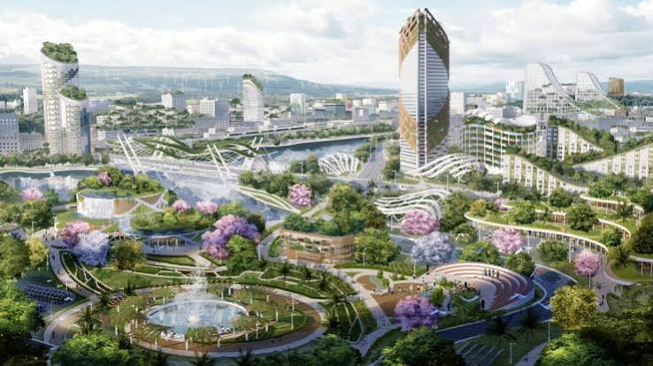
Investigating & Defining
Explore Solarpunk
Investigating & Defining
Explore the concept of Solarpunk online and try to identify key themes in this hopeful vision of a sustainable future.
Choose one solarpunk image that you think could help to address the issues futures cities are facing, paste it in the space provided
Annotate it, labelling all of the important elements that you think could be applied to a future version of Melbourne.
Examples of Solarpunk
.
Lots of trees
Looks sustainable
Generating & Designing
Different kinds of trees
Lots of water
Producing & Implementing
Planning & Managing
fountain
The houses are all in an apartment so its using less of the ground space for trees
There are wind mills in the distance
Evaluating

Slide 8
Future Challenges
Investigating & Defining
Investigating & Defining
Reflect on the suggested challenges facing your town's future and provide detailed explanations on why you think these issues will be challenging to tackle.
Feel free to explore as many concepts as you wish before deciding on a specific area to concentrate on during the subsequent stages of the design process.
Challenge Category | Specific Challenge (2050) | Why Will This Be a Challenge?
Economic | Fewer businesses in town | Less jobs available
Economic | Limited Infrastructure | Less houses so more homeless
Social | Young people moving to cities for work | Too many people in cities
Social | Limited Infrastructure | More homeless people
Social | Mental health issues | Higher suicide rates
Environmental | More extreme weather (fires, storms, floods) | Destroyed buildings
Environmental | Loss of nature & wildlife | sad
Environmental | Too much waste & pollution | Makes the air gross
Generating & Designing
Producing & Implementing
Planning & Managing
Evaluating

Slide 9
Mind Map
Investigating & Defining
Investigating & Defining
Use the Mind Map template to organise your ideas and guide your project.
Key Issues (Blue Boxes):
Identify 4 key issues related to the future of your town and write them in the blue boxes.
Related Aspects (Red Boxes): For each key issue, list 3 related aspects in the red boxes.
Use the example and AI to help identify key issues and ways to address them.
Storms
Fire Threat
Less houses
Less business’
Generating & Designing
Extreme Weather
Limited infrastructure
Floods
More homeless
Producing & Implementing
Your Town 2050
Lack of affordable housing
Young people moving to cities for work
Planning & Managing
Not enough housing
Evaluating
homeless
Buildings going to waste
Makes house prices higher
Not enough jobs

Slide 10
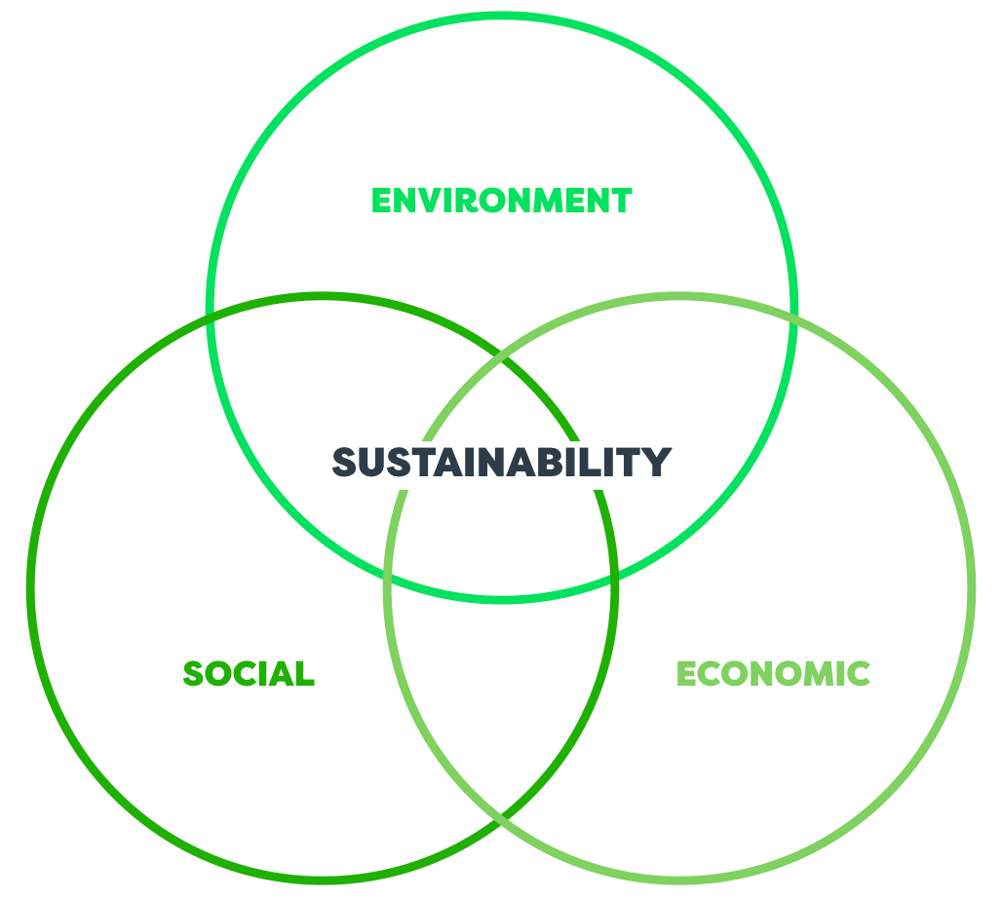
3 Pillars of Sustainability
Investigating & Defining
Investigating & Defining
Identify 3 ways cities can be more sustainable
Use the template to unpack 3 ways that your town could be more sustainable.
Environmentally
How can we design a future town that protects the environment and uses resources wisely?
Socially
How can we make a town fair, welcoming, and accessible for everyone?
Economically
How can a town create jobs and grow its economy while staying affordable and sustainable?
Environmentally
Economically
Generating & Designing
Solar panels will help with using sustainable energy, and lots of trees will be good.
- wind mills for sustainable energy
- Have more stores to create more jobs, building stores will also create more jobs.
Producing & Implementing
Socially
Planning & Managing
- All stores and public places should be accessible for the disabled so everyone is able to live there.
Evaluating
Use online research and AI
tools to find solutions or ideas.

Slide 11
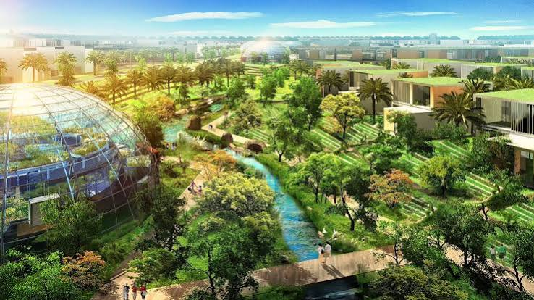
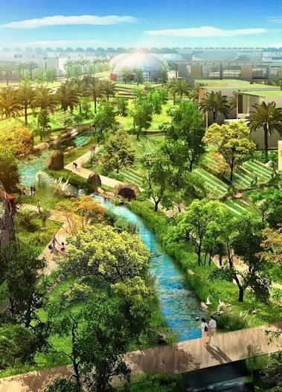
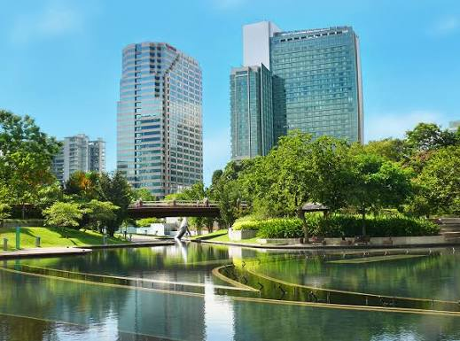
Investigating & Defining
Visual Research of Structures
Investigating & Defining
Collect Images:
Find images of different structures that could be used to support your vision of your town in 2050.
Annotate Your Images:
For each image, write a short note explaining:
What it shows.
How it relates to your key issue.
How it might help or inspire your design project.
Organise and Reflect:
Arrange the images and annotations clearly in your portfolio.
Highlight any ideas or features you think are especially useful for your project.
Collect a broad range of examples from social media.
Annotate each example you find to explain what you learned from it.
You could also focus on different areas of interactive media design if helpful.
Add as many pages as required.
Generating & Designing
Producing & Implementing
Planning & Managing
Evaluating
Add pages as necessary.

Slide 12
Investigating & Defining
Share
Generating & Designing
Producing & Implementing
What are the key areas you would like feedback on?
What challenges have you identified?
What opportunities have you identified?
What’s next?
Planning & Managing
Evaluating

Slide 13
Design Brief
Generating & Designing
Investigating & Defining
Use this Design Brief Starburst template to identify specific things to focus on in your design project.
Who
What
When
Where
Why
How
What is the specific problem?
Not enough buildings
Choose one of the issues your group investigated to solve and identify the specific problem you are trying to solve
What specific problem are you trying to raise awareness of?
Who are you trying to help?
When will this be used?
Where will it be used?
Why is it needed?
How could it help?
Generating & Designing
How could it help?
It will give everyone a
A place to
live
Who will you be helping? The homeless
What is the specific problem or opportunity you are hoping to address?
Producing & Implementing
Why is it needed? Because there are so many people with no homes
When will this be used? ????
Planning & Managing
Where will this be used? everywhere
Evaluating

Slide 14
Generating & Designing
Evaluation Criteria
Investigating & Defining
Develop on a set of evaluation criteria that you will use throughout the design process to evaluate your design concepts.
Use information from your research and design brief starburst to identify 5 important requirements for your design concept.
You can use the following prompts to start your criteria.
It must …
It should…
It will…
It must be sustainable
Generating & Designing
It will encourage people to live and work in our town
Producing & Implementing
It will be accessible for everyone
It will have enough jobs and homes for everyone
Planning & Managing
Evaluating

Slide 15
Morphological Matrix
Investigating & Defining
Generating & Designing
Use your personal knowledge and this Morphological Matrix to help generate ideas for the type of designs you will create for an audience of your choosing.
On the next page, you can mix and match options from each column to generate different design options.
Technology-Based Solution | Community & Social Solution | Policy & Government Action | Education & Awareness | Infrastructure
Smart waste sorting & recycling tech | Zero-waste community initiatives | Laws to protect ecosystems | Entrepreneurship training in schools | Advanced water recycling systems
Climate-resistant buildings & early warning systems | Community business incubators | Stronger climate adaptation policies | Teaching climate change adaptation | Electric vehicle charging stations
Smart transport systems | Local networking & mentoring programs | Rent control & affordable housing policies | Career education focused on regional opportunities | Better road and bridge maintenance
3D-printed eco-homes | Cooperative housing projects | Government investment in roads & public services | Teaching students about infrastructure planning | Expanded public transport networks
AI-powered mental health apps | Emergency response teams & resilience training | Free regional mental health clinics | Mental health education in schools | High-speed internet for all areas
Online marketplaces for local goods | Peer support & well-being programs | Funding for regional job creation | Sustainability education programs | Smart grids for renewable energy
Remote work hubs & co-working spaces | Community tree-planting & wildlife protection groups | Tax incentives for startups | Teaching sustainable housing design | Affordable modular housing developments
Rewilding projects & AI conservation tracking | Volunteer repair & maintenance groups | Bans on single-use plastics & stronger regulations | Environmental education in schools | Green urban spaces & rooftop gardens
Generating & Designing
Producing & Implementing
Planning & Managing
Evaluating

Slide 16
Investigating & Defining
Generating & Designing
Design Option #1
Technology-Based Solution | Community & Social Solution | Policy & Government Action | Education & Awareness | Infrastructure
Solar panels | Accessible for everyone |  | Education for everyone | Eco buildings
Use this page to create 3 possible design options to meet your design challenge.
Get feedback from others to help you decide which one to further develop into a final solution.
Generating & Designing
Design Option #2
Technology-Based Solution | Community & Social Solution | Policy & Government Action | Education & Awareness | Infrastructure
Wind turbines |  |  | Education for everyone | Eco buildings
Producing & Implementing
Planning & Managing
Design Option #3
Technology-Based Solution | Community & Social Solution | Policy & Government Action | Education & Awareness | Infrastructure
Solar panels & wind turbines |  |  | Education for everyone | Eco buildings
Evaluating

Slide 17
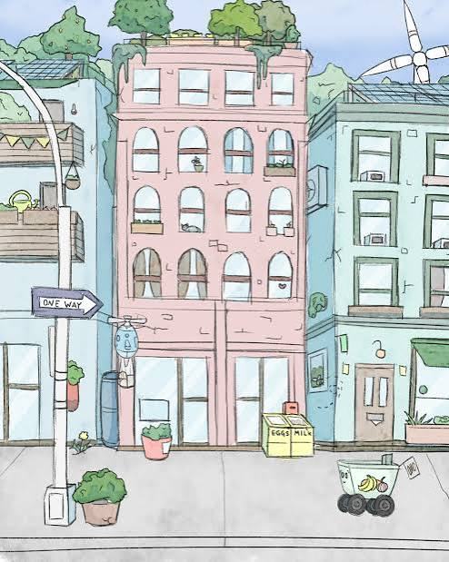
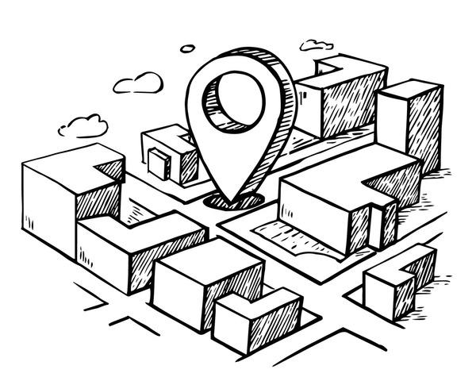
Investigating & Defining
Generating & Designing
Future Town Concept Features
Sketch your ideas for the features of your future town.
Use your research to inspire creative and practical ideas.
Highlight how these features will make the town more sustainable, accessible, and enjoyable for everyone.
Add notes to explain the purpose, function, and design of each feature.
You can draw your ideas on paper and upload photos or use CAD software if preferred.
←lots of plants
Create game structure proposals by selecting and combining different options in the Morphological Matrix page.
You can also start sketching ideas at this stage if it helps you to visualise your ideas.
Informal feedback from classmates might also help if you are stuck.
Choose your favourite structure to further develop in the following stages
←Wind turbines
Generating & Designing
solar panels ->
Producing & Implementing
Planning & Managing
←compost
Evaluating
Add pages as necessary.

Slide 18
Investigating & Defining
Share
Generating & Designing
Producing & Implementing
What are the key areas you would like feedback on?
What challenges have you encountered?
What opportunities have you identified?
What’s next?
Planning & Managing
Evaluating

Slide 19
Create your design
List things you will need to add to your VR world and how they will assist the user to understand the concept presented.
I want my user to see an eco city/town
I want them to see how they could make there own lives more sustainable
It could be an even better experience if there is pink frogs and other animals It would be cool to add a pink frog.
And pink houses too
I could add compost bins
Lots of solar panels
I want the pink frogs to dance, they will do backflips

Slide 20
Checkpoint:
At the end of each lesson in the development stage week 4 & 5, create a new slide to your portfolio with the following:
What I achieved today, including screenshots:
What I had trouble with:
What I need to work on tomorrow:

Slide 21
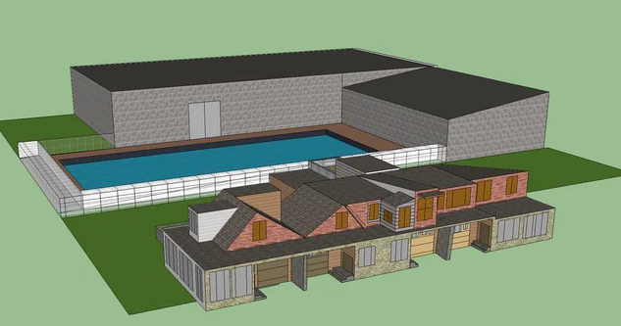
Producing & Implementing
Final Design (CAD/ VR world)
Investigating & Defining
Show your final design concepts here
Use Computer Aided Design (CAD) software if possible (any software)
Sketchup Help Videos
Add as much detail as possible
Annotate to explain your final design
Use colour and appropriate material textures to bring your solution to life.
Create game structure proposals by selecting and combining different options in the Morphological Matrix page.
You can also start sketching ideas at this stage if it helps you to visualise your ideas.
Informal feedback from classmates might also help if you are stuck.
Choose your favourite structure to further develop in the following stages
Generating & Designing
Producing & Implementing
Planning & Managing
Evaluating
Add pages as necessary.

Slide 22
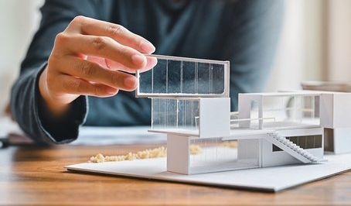
Planning and Managing
Production Planning
Investigating & Defining
Use this page to help plan production of your prototype, whatever you think will be most effective approach for creating your design concept.
List all materials and equipment you think may be used.
Production Step | Proposed Process | Materials And Equipment Required
Generating & Designing
Producing & Implementing
Planning & Managing
Evaluating
Add pages as necessary.

Slide 23
Evaluating
Design Reflection
Investigating & Defining
Use this page to evaluate the potential of your design against the criteria you specified earlier.
Where possible identify further improvements that could be made.
What should be the positive impacts of your design?
What could be the potential negative impacts of your design?
Your Evaluation Criteria | Potential of Your Design | Possible Improvements
Generating & Designing
Producing & Implementing
Planning & Managing
Evaluating

Slide 24
Feedback Rubric
Investigating & Defining
Stage | Task | Below the Level | Working Towards the Level | At the Level | Above the Level
Investigating & Defining | Explore Solarpunk & Annotate Image | Image is missing or lacks annotations | Image is present with minimal annotations or unclear links to town redesign | Image is annotated with relevant elements and clear connections to town redesign | Image is annotated with insightful comments and detailed connections to sustainability and urban design
 | Future Challenges Reflection | Few or no challenges identified, lacks explanation | Some challenges identified, but explanations are brief or unclear | Challenges are well-identified with clear reasoning for their impact | Challenges are thoroughly analyzed with deep insights and examples
 | Mind Map of Key Issues | Mind map is incomplete or lacks structure | Mind map identifies some key issues, but connections are weak | Mind map effectively organizes key issues and related aspects | Mind map is detailed, well-structured, and shows deep analysis of interconnections
 | Sustainability Analysis (3 Pillars) | Few sustainability solutions presented, lacks explanation | Some sustainability solutions identified but not well-supported | Sustainability solutions are well-explained across social, economic, and environmental aspects | Sustainability solutions are highly innovative, well-researched, and linked to real-world examples
 | Visual Research of Structures | Few images collected, no annotations | Some images collected with minimal annotations | A variety of images with clear annotations explaining relevance | Highly relevant images with detailed annotations, showing deep critical thinking
Generating & Designing | Design Brief (Starburst Template) | Design brief is missing or lacks focus | Some aspects of the brief are present but unclear | Design brief is well-structured with clear objectives | Design brief is detailed, insightful, and demonstrates strong problem-solving
 | Evaluation Criteria | Few or no evaluation criteria listed | Some criteria listed but vague or incomplete | Clear, relevant evaluation criteria aligned with the design | Well-developed, specific criteria that enhance the design process
 | Morphological Matrix & Idea Generation | Few or no ideas generated | Some ideas generated but lack variety or relevance | A variety of ideas generated using the matrix | Highly creative, well-developed ideas that explore multiple innovative solutions
 | Sketches & Concept Features | Sketches are missing or lack detail | Basic sketches with minimal features | Detailed sketches with clear labels and explanations | Highly detailed sketches with annotations explaining functionality and sustainability
Producing & Implementing | Final Design (CAD or Sketch) | Design is incomplete or lacks clarity | Basic design with minimal detail or annotations | Clear, well-developed design with appropriate materials and textures | Highly polished, professional-level design with thoughtful annotations and presentation
Planning & Managing | Production Planning | Plan is incomplete or lacks detail | Some materials and steps listed but lacks depth | Clear plan outlining materials, tools, and process | Highly organized, efficient plan considering alternatives and challenges
Evaluating | Design Reflection & Impact Evaluation | Little or no reflection on design impact | Some reflection, but lacks depth or specific improvements | Clear evaluation considering strengths and areas for improvement | Deep analysis of design impact, including ethical, social, and environmental
Generating & Designing
Producing & Implementing
Planning & Managing
Evaluating

